Slide 1

Data Analytics Project

Slide 2
Team Members
كريم اسامة مرسي الاباصيري 20201701186
نادين عمرو خالد الزغبي 20201700901
احمد رمضان اسماعيل عبد العليم 20201701049
نانيس عادل شحاتة حسن 20201700909
نوران سمير احمد حسب عوف 20201700934
يوسف عبد الرؤوف امين محمود 20201701019

Slide 3
Data set
Our data set contains sales data of mobile phones of various companies.
It is a classification problem
Our objective is to find out some relation between features of a mobile phone(e.g.:- RAM,Internal Memory ,etc) and its selling price.
In this classification problem we predict a price range indicating how high the price is.

Slide 4
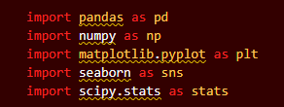
Data Preprocessing
We performed several preprocessing steps on the dataset stored in a CSV file. Here's a breakdown of each step:
Reading the CSV data: The pd.read_csv() function is used to read the dataset from a file located at 'D:/Study/Projects/Data Analytics Project/train.csv ' into a Pandas DataFrame named data.
Summarizing the data: The data.info() function is used to display information about the DataFrame, including the number of rows, columns, and data types of each column. The data.head(5) and data.tail(5) functions are used to display the first and last 5 rows of the DataFrame, respectively. The data.describe() function is used to summarize the numeric columns of the DataFrame.

Slide 5
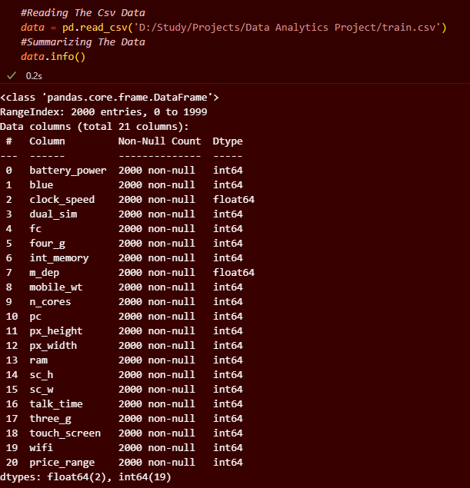

Slide 6
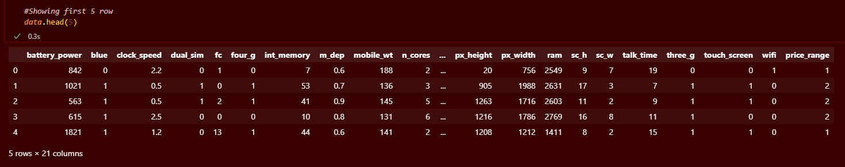
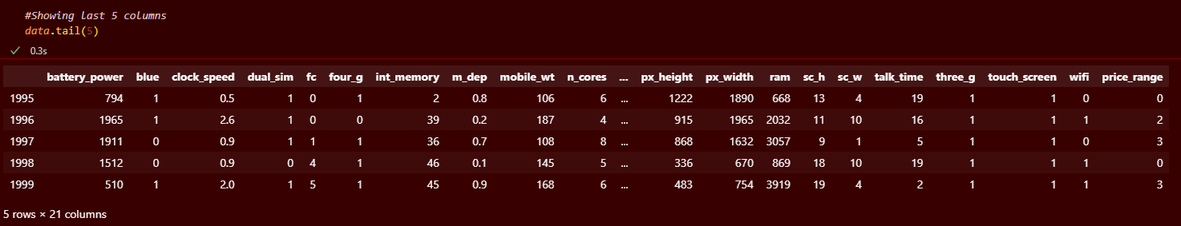

Slide 7
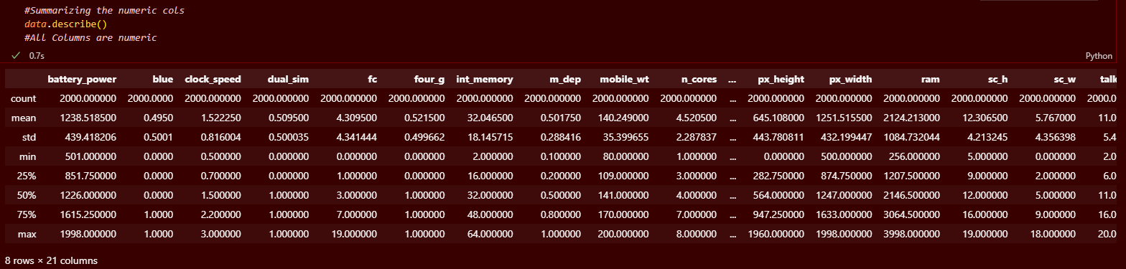
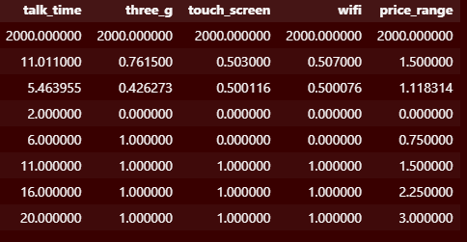

Slide 8

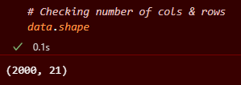
Data Preprocessing
Removing duplicate data: The data.duplicated() function is used to check for duplicate rows in the DataFrame. If duplicates are found, they are removed using the data.drop_duplicates(inplace=True) function.
Renaming columns: The data.rename() function is used to rename the columns of the DataFrame to more readable names.

Slide 9
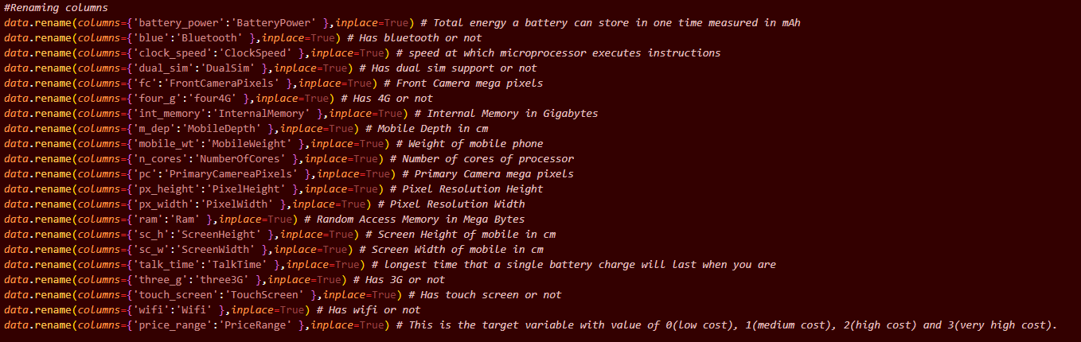

Slide 10
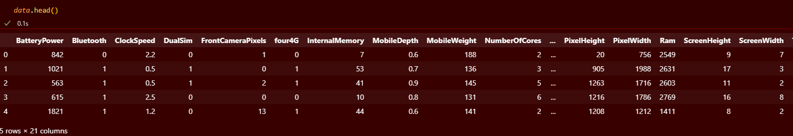
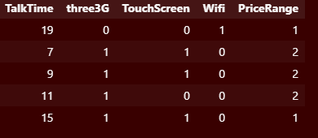

Slide 11
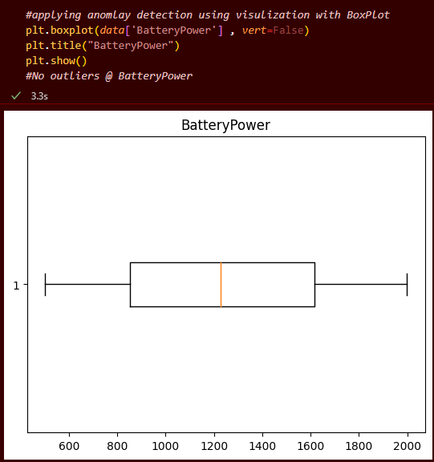
Data preprocessing
Handling outliers: Box plots are used to identify columns with outliers. The plt.boxplot() function is used to display a box plot for each column. If outliers are detected, they are removed using the Z-score method. First, the absolute Z-score is calculated for each observation using the np.abs(stats.zscore(data)) function. Then, rows with all Z-scores less than 2.75 (a threshold chosen based on the box plot) are kept in the cleaned data DataFrame data_clean.

Slide 12
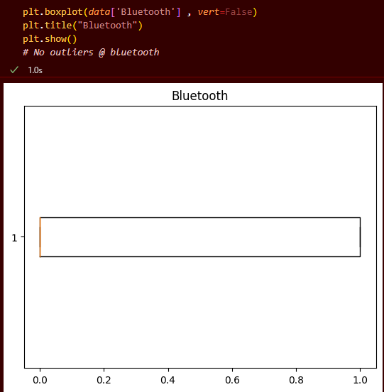
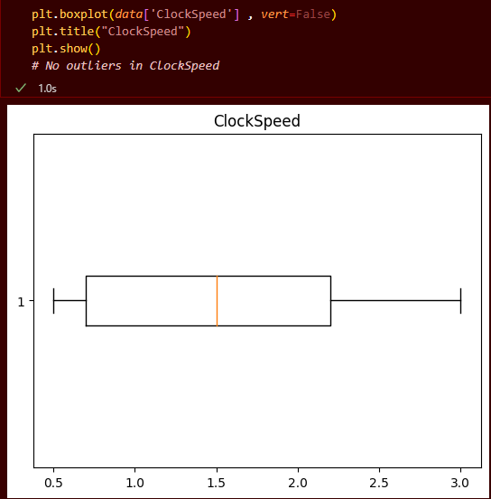

Slide 13
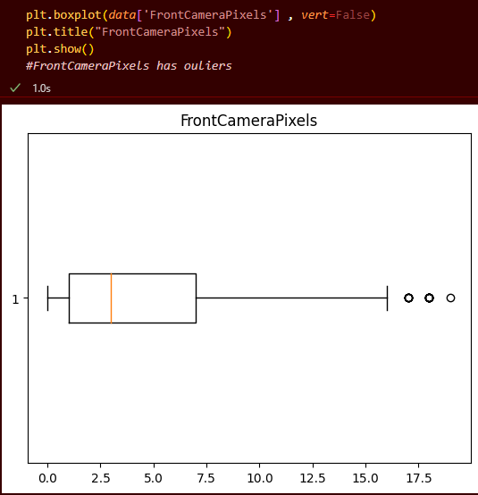
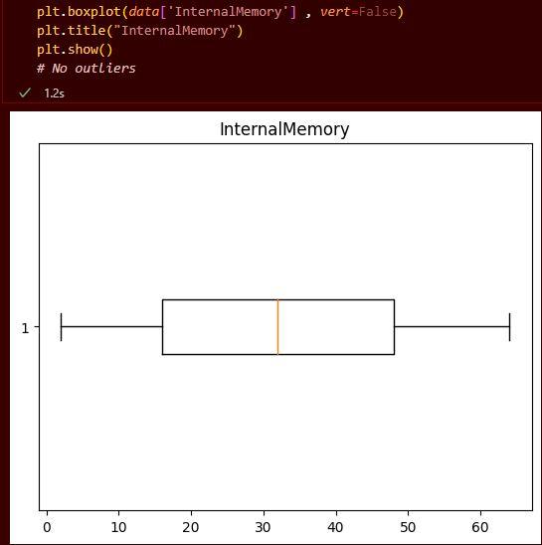
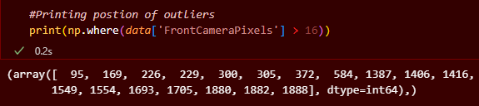

Slide 14
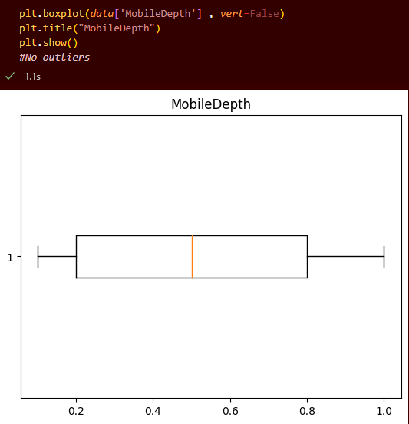
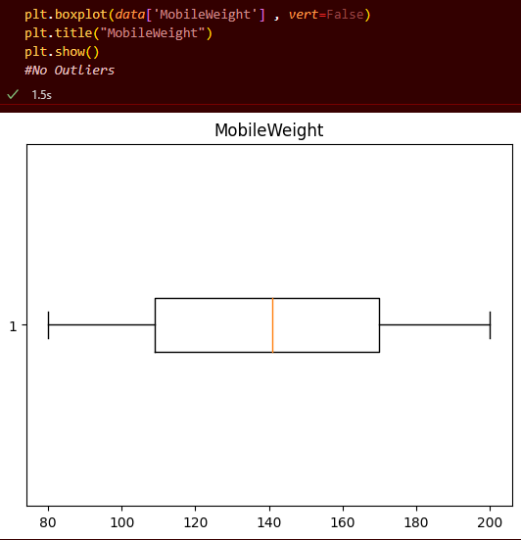

Slide 15
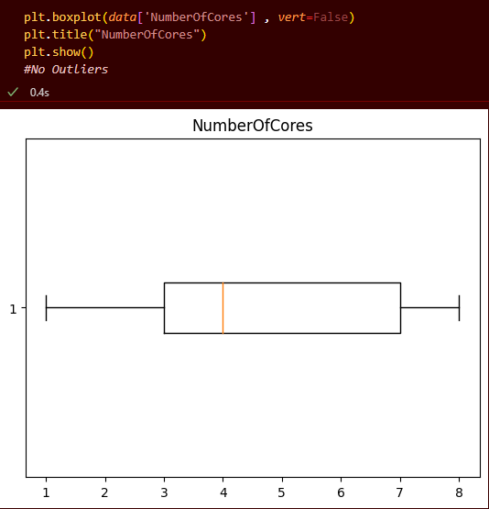
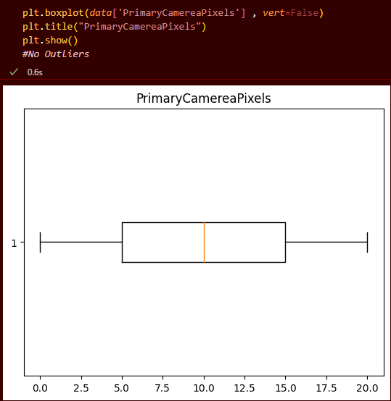

Slide 16
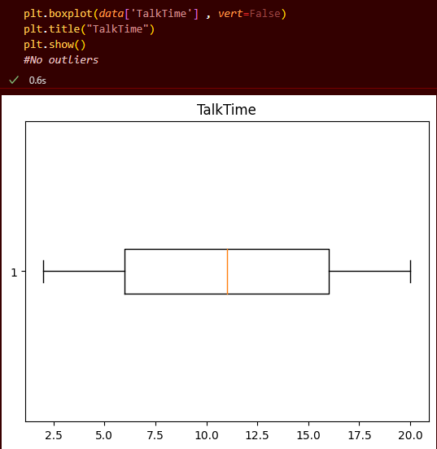
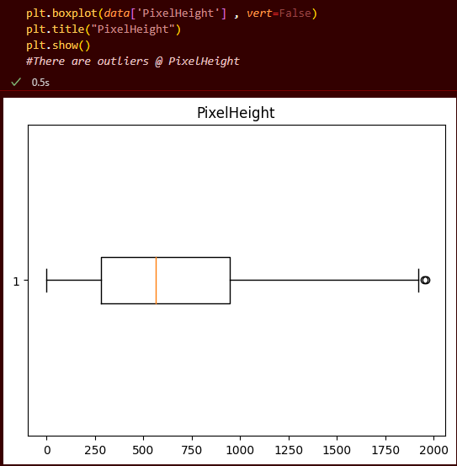


Slide 17
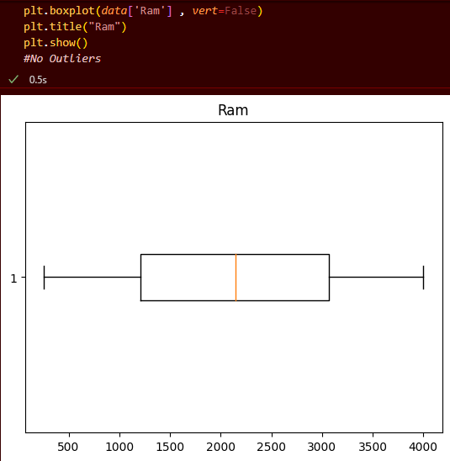
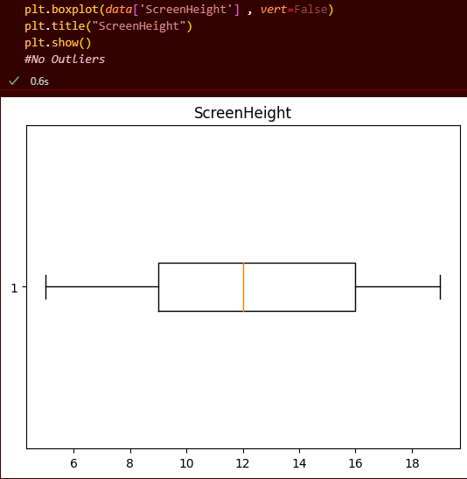

Slide 18
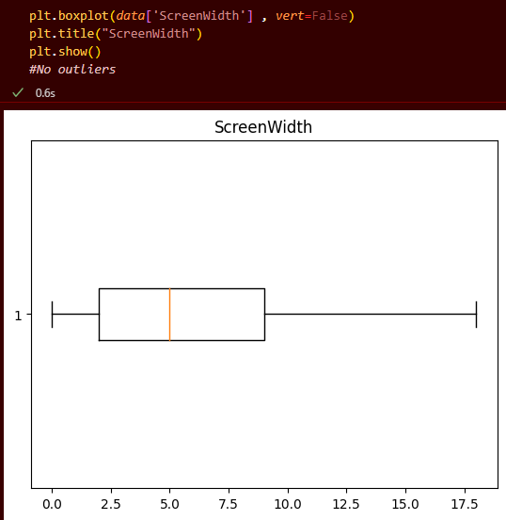
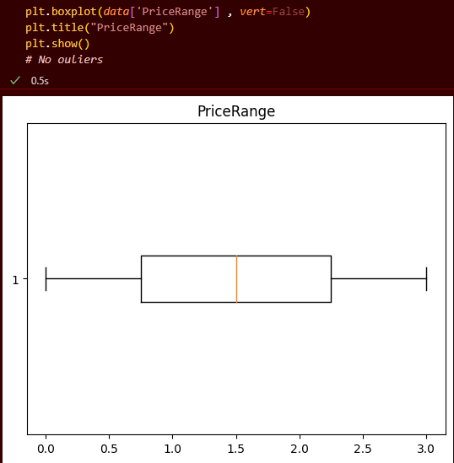

Slide 19

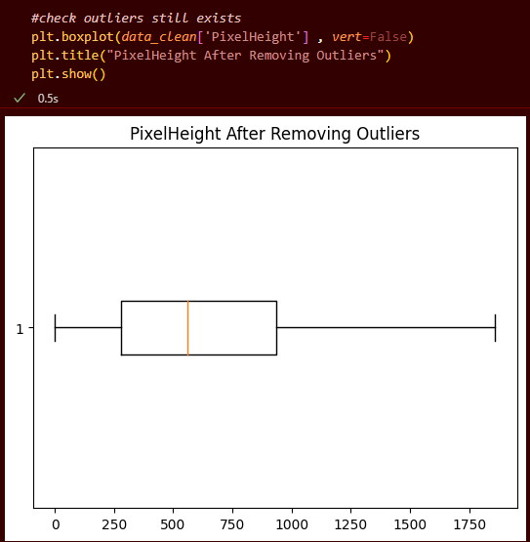

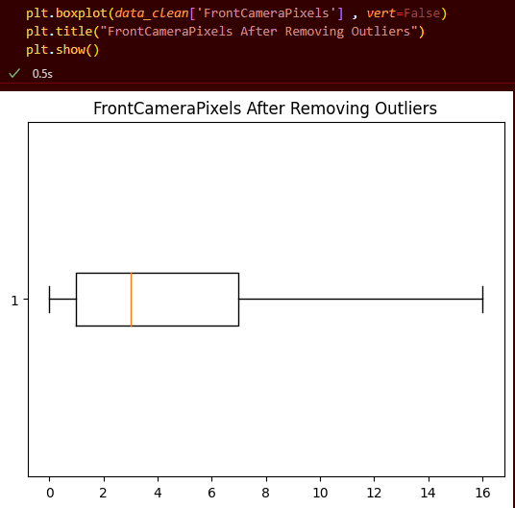

Slide 20
Overall, the preprocessing steps performed in this code aim to clean and prepare the dataset for further analysis, including outlier detection and removal.

Slide 21
Data Analysis
We performed some analysis steps on the dataset:
We have calculated the variance for all columns using .var(). Higher variance indicates a wider spread of values in that column.
We found that columns like BatteryPower, InternalMemory, MobileWeight, PixelHeight, PixelWidth and Ram have high variance, indicating dispersed data.
Columns like Bluetooth, ClockSpeed, DualSim, TouchScreen, Wifi, PriceRange and 4G have lower variance, indicating the data is closer together.
We calculated the mode for all columns using statistics.mode() to find the most frequent value. This indicates the peak of the distribution.

Slide 22
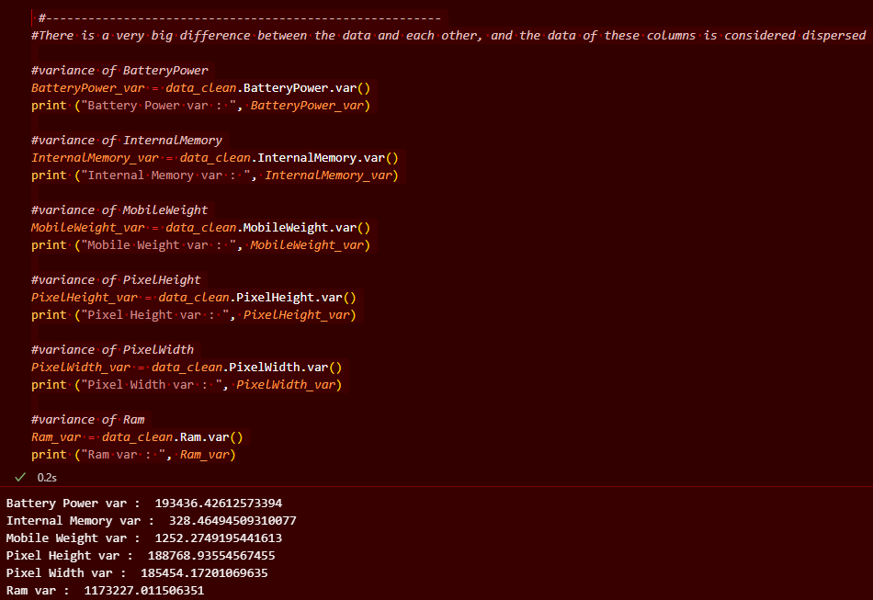

Slide 23
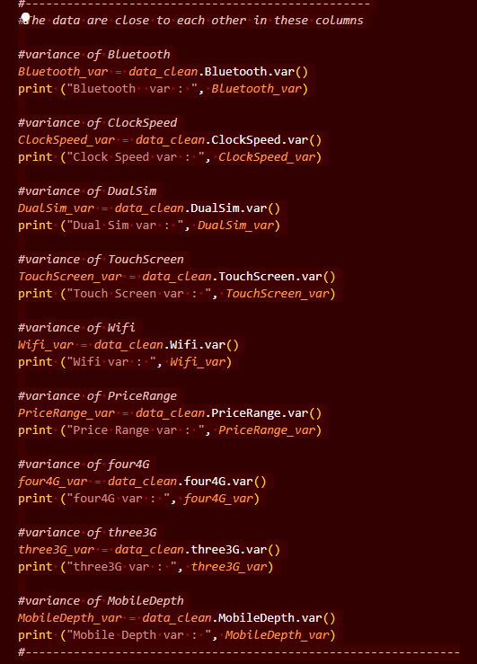
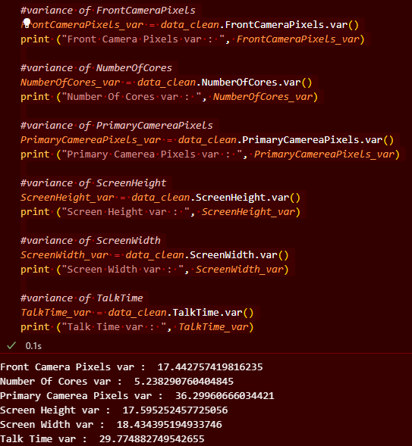
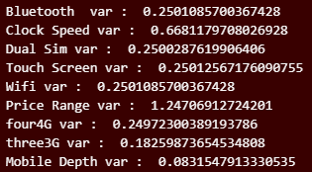

Slide 24
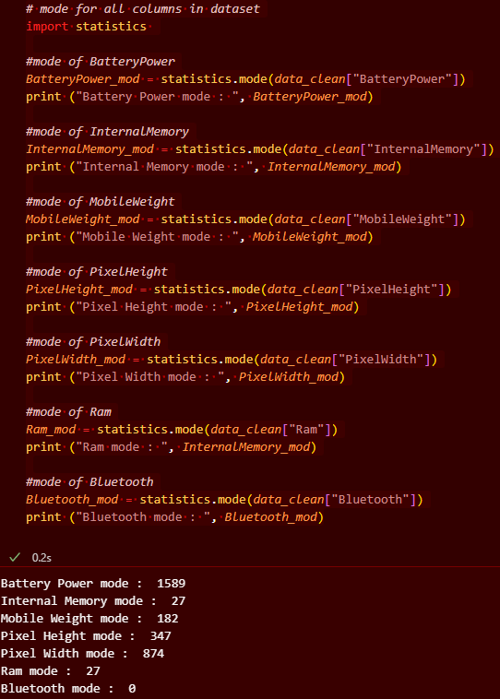
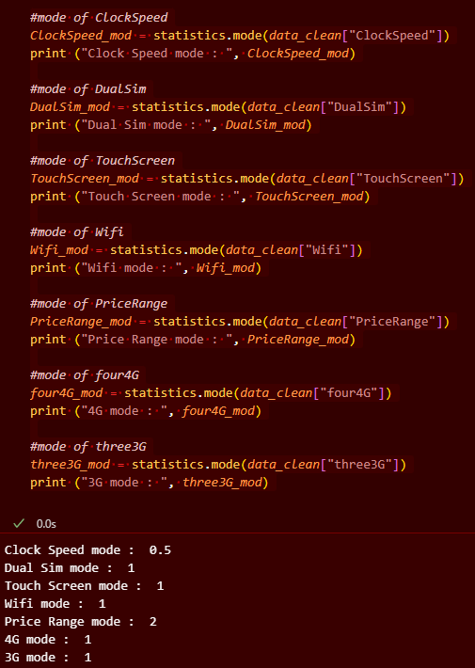

Slide 25
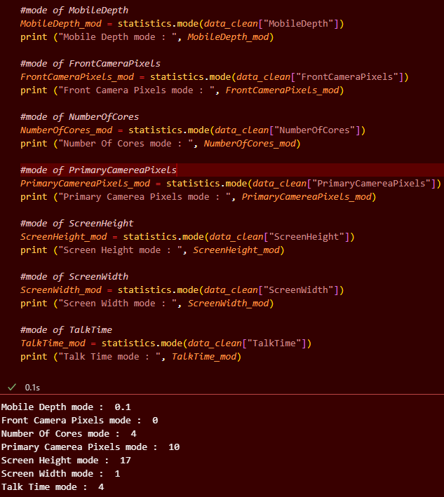

Slide 26
Data Analysis
We calculated the interquartile range (IQR) using .describe(). Higher IQR indicates a wider spread, excluding the outliers.
Columns with high variance like BatteryPower and PixelHeight also have high IQR, showing a wide spread of data
Columns with low variance like Bluetooth and ClockSpeed have low IQR, showing the data is closer together.
We generated a correlation matrix using .corr() to determine the strength of correlation between all columns. This shows which features are positively or negatively correlated.

Slide 27
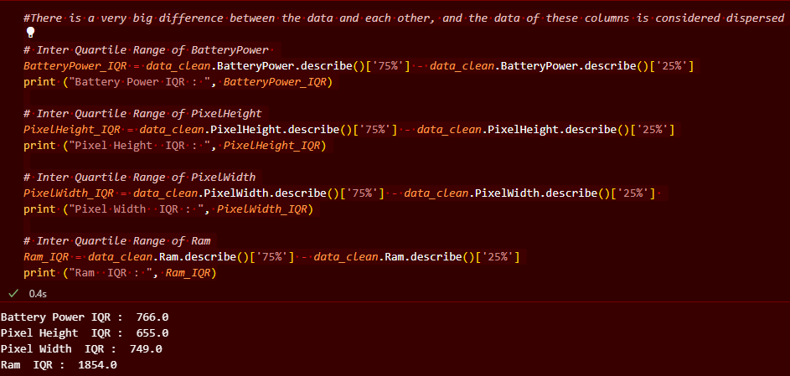

Slide 28
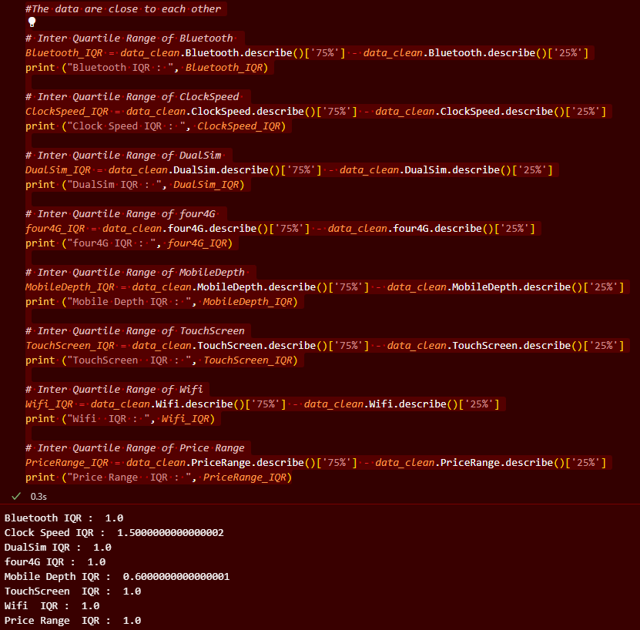

Slide 29
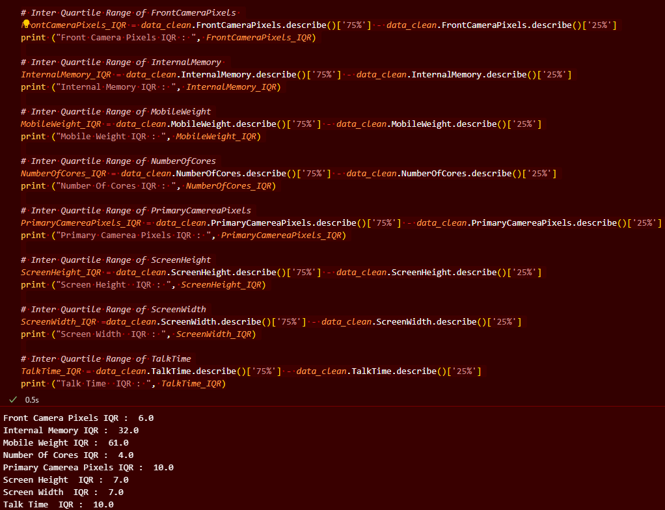

Slide 30
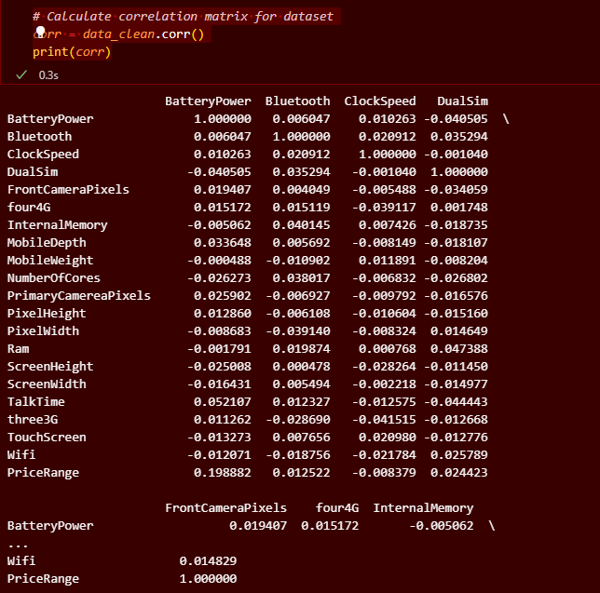

Slide 31
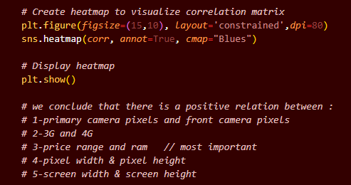
Data Visualization
We performed some visualization on the dataset:
we created a correlation heatmap to visualize the correlation matrix. we found that:
Primary camera pixels and front camera pixels are positively correlated.
3G and 4G are positively correlated. More phones have both 3G and 4G.
Price range and RAM are strongly positively correlated. Higher RAM means higher price.
Pixel width and height are also correlated.

Slide 32
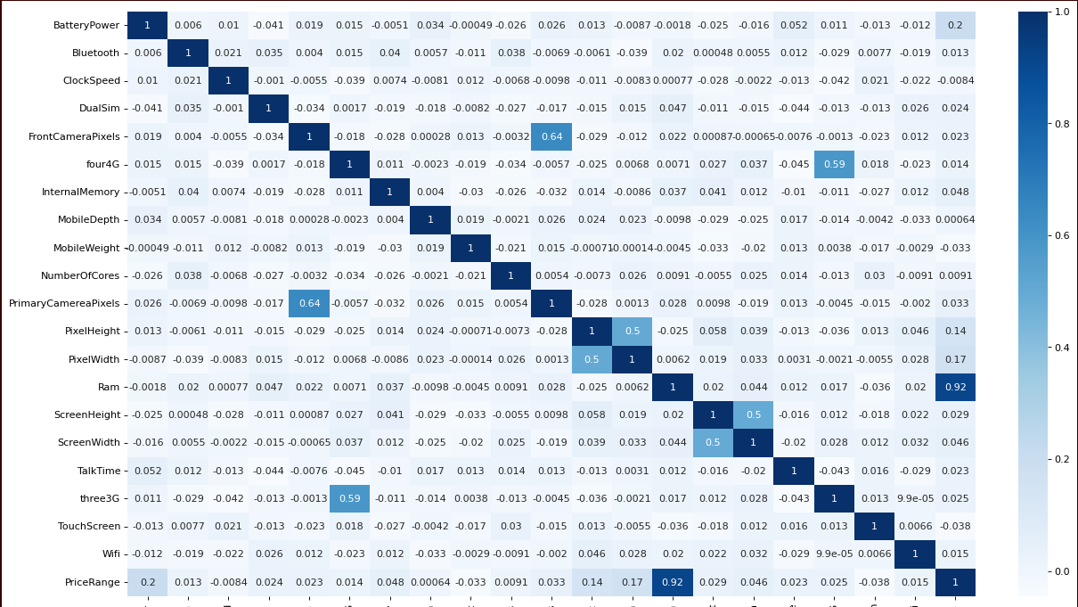

Slide 33
Data Visualization
Visualizations:
Histograms show:
Clock speed is right skewed with more phones having lower clock speeds.
Front camera pixels and screen height have significant differences in values.
RAM and mobile weight values are relatively clustered.

Slide 34
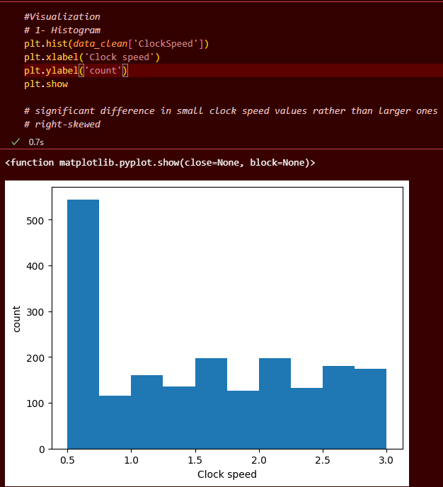
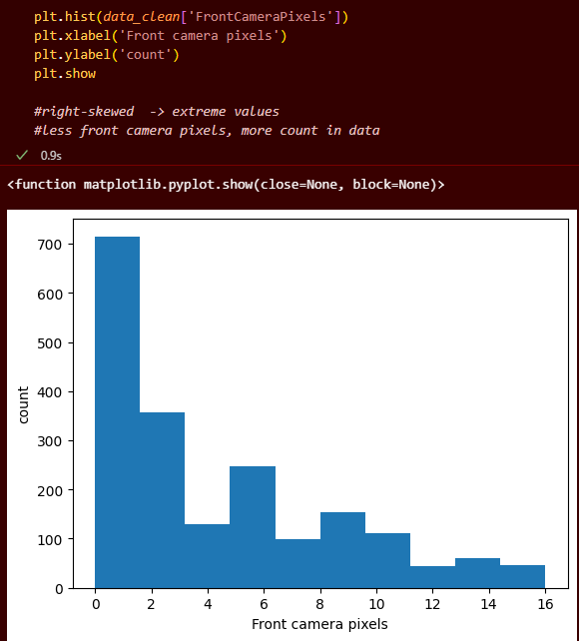

Slide 35
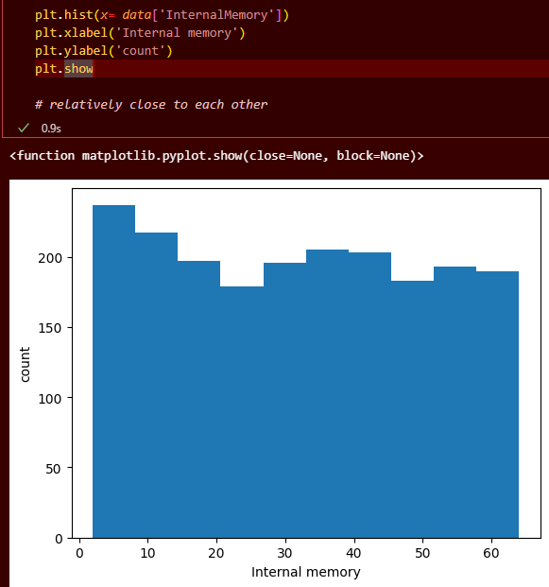
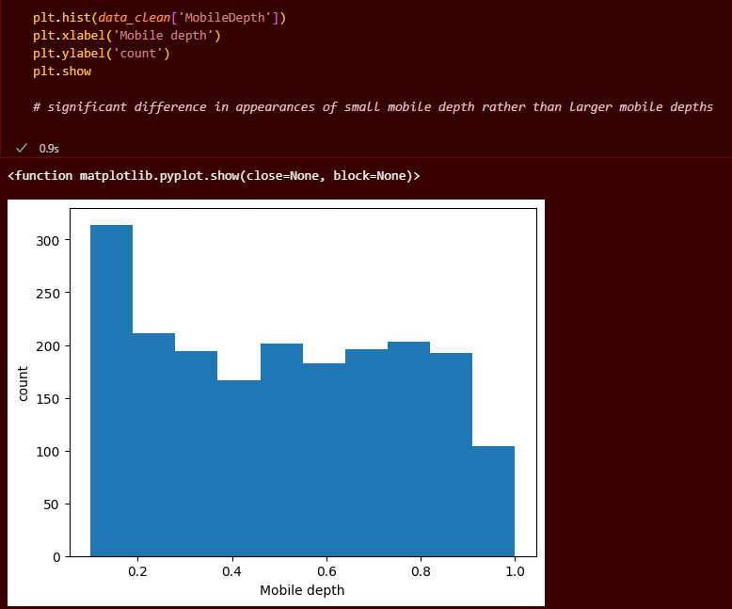

Slide 36
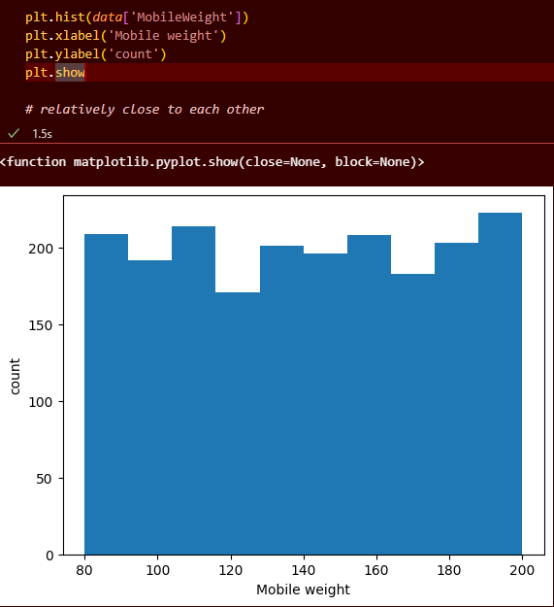
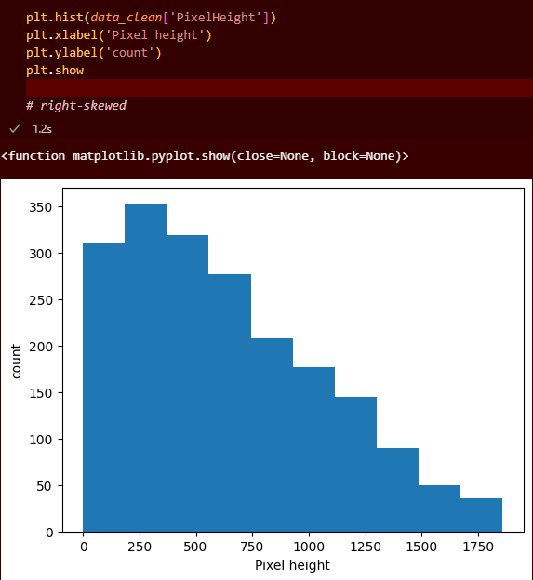

Slide 37
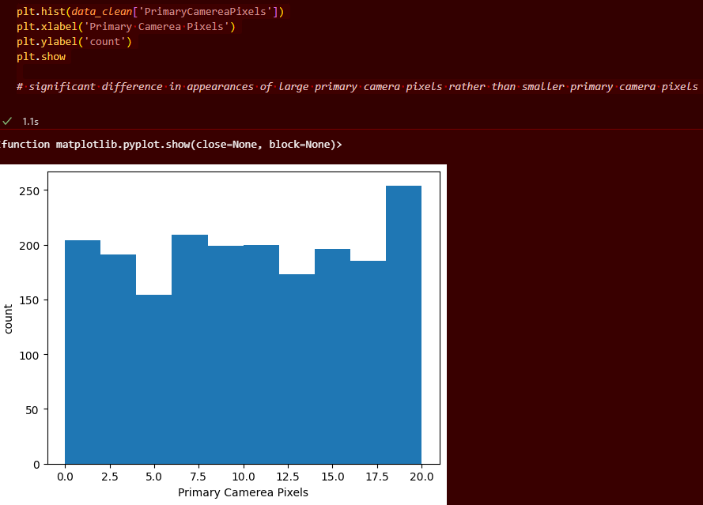

Slide 38
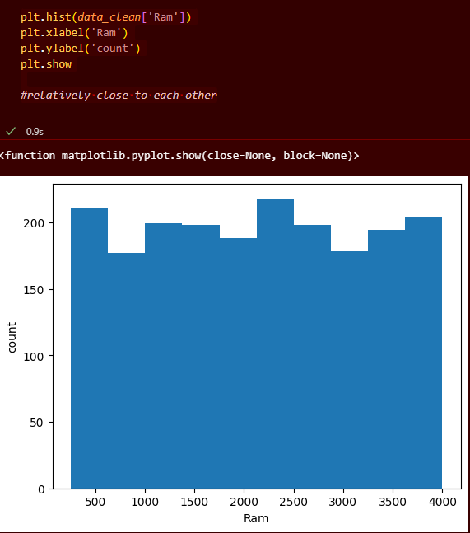
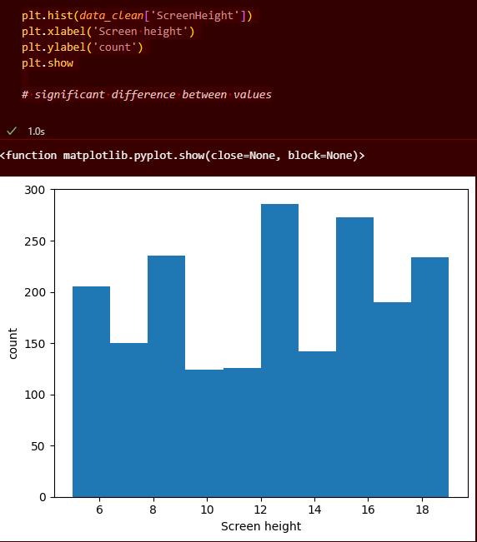

Slide 39


Slide 40
Data Visualization
Density plots show:
RAM increases with price range.
Dual SIM phones have higher price ranges.
Front camera pixels are right skewed with most phones having lower values.
Battery power and price range are positively correlated.

Slide 41



Slide 42



Slide 43


Slide 44
Data Visualization
Countplots show:
Most phones have WiFi.
Phones without Bluetooth tend to have lower price ranges.
More phones have both 3G and 4G.
4-core phones are most common in the higher price range.
Number of cores and price range are positively correlated.

Slide 45



Slide 46



Slide 47



Slide 48


Slide 49


Data Visualization
Piecharts show:
Price range is equally distributed
4G mobiles are found more than those without 4G

Slide 50
Data Visualization
Scatterplots show:
Higher RAM means higher price range.
Primary and front camera pixels are positively correlated.
No clear relationship between battery power and talk time.

Slide 51



Slide 52


Slide 53
Overall, our analysis uses a variety of measures and plots to analyze the spread, skewness, relationships and distributions within the data.

Slide 54


Data Modelling
We performed two main steps in our model building process:
Data preparation:
We split the dataset into X (features) and y (target). X contains all columns except PriceRange and y contains just the PriceRange column.
Since PriceRange is a categorical column with 3 classes, this is a classification problem.
We split the data into 70% train and 30% test using train_test_split().

Slide 55

Data Modelling
Model Training and Evaluation::
Random Forest:
We trained a RandomForestClassifier using X_train and y_train.
Predicted on the test set using .predict() and calculated:
Because it is a balanced classification, average='macro' which averages the metrics across labels, giving equal weight to each class, works best for our data.
Accuracy: 0.86779 Precision: 0.86779 Recall: 0.86779

Slide 56

Data Modelling
KNN:
Trained a KNeighborsClassifier model.
Predicted on the test set and calculated metrics:
Accuracy: 0.918 Precision: 0.919 Recall: 0.919

Slide 57

Data Modelling
Decision Tree:
Trained a DecisionTreeClassifier.
Calculated metrics on test predictions:
Accuracy: 0.806 Precision: 0.808 Recall: 0.808

Slide 58
In the end, KNN performed best with 92% accuracy Random Forest achieved 88% accuracy Decision Tree achieved 81% accuracy, the lowest of the three models All models had slightly lower recall, indicating some false negatives

